Slide 1
Algorithm Analysis
Measuring performance

Slide 2

Why?
Efficiency: How can we process much larger volumes of data at current hardware capacity

Slide 3
Finding Novel Words in Shakespeare Sonnets
A file containing all the unique words found in Shakespeare sonnets
sonnets_words.txt (length: 2854)
A file containing all unique words used in English-language Scrabble tournaments
sowpods.txt (length: 267751)

Slide 4
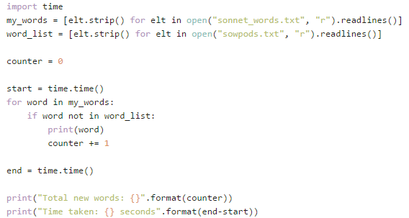
Attempt 1: Using List

Slide 5
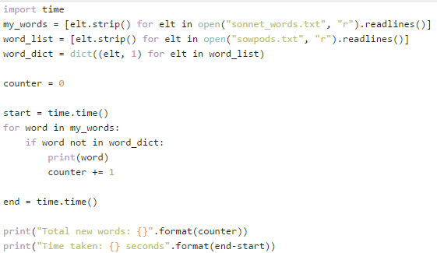
Attempt 2: Using dictionaries

Slide 6
Why are Python lists so slow?
Hint: Underlying implementation is an array implementation

Slide 7
Python List
https://wiki.python.org/moin/TimeComplexity
Internally, a list is represented as an array, but with ability to resize
Fast
access (get item, set item)
get length
Pop last item
Slow
Insert
Delete
Insert

Slide 8
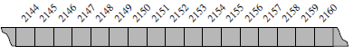
Underlying machine storage
A representation of a portion of a computer’s memory, with individual bytes
labelled with consecutive memory addresses
Notes:
A computer system will have a huge number of bytes of memory, and to keep track of what information is stored in what byte, the computer uses an abstraction known as a memory address. In effect, each byte of memory is associated with a unique number that serves as its address (more formally, the binary representation of the number serves as the address). In this way, the computer system can refer to the data in “byte #2150” versus the data in “byte #2157,” for example. Memory addresses are typically coordinated with the physical layout of the memory system, and so we often portray the numbers in sequential fashion.
Despite the sequential nature of the numbering system, computer hardware is designed, in theory, so that any byte of the main memory can be efficiently accessed based upon its memory address. In this sense, we say that a computer’s main memory performs as random access memory (RAM). That is, it is just as easy to retrieve byte #8675309 as it is to retrieve byte #309. (In practice, there are complicating
factors including the use of caches and external memory)

Slide 9
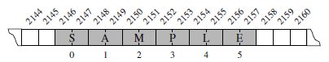
Low level Arrays
A group of related variable stored one after another in a contiguous portion of the computer’s memory.
A Python string embedded as an array of characters in the computer’s memory. We assume that each Unicode character of the string requires two bytes of memory. The numbers below the entries are indices into the string.
Each cell of an array must use the same number of bytes. This requirement is
what allows an arbitrary cell of the array to be accessed in constant time based on its index.
Notes:
We describe this as an array of six characters, even though it requires 12 bytes of memory. We will refer to each location within an array as a cell, and will use an integer index to describe its location within the array, with cells numbered starting with 0, 1, 2, and so on. For example, in Figure 5.2, the cell of the array with index 4 has contents L and is stored in bytes 2154 and 2155 of memory
Each cell of an array must use the same number of bytes. This requirement is
what allows an arbitrary cell of the array to be accessed in constant time based on
its index.

Slide 10
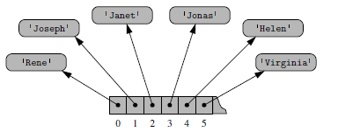
Referential Arrays
Python represents a list / tuple instance using this internal storage mechanism of an array of object reference.
At the lowest level, what is stored is a consecutive sequence of memory addresses at which the elements of the sequence reside.
Although the relative size of the individual elements may vary, the number of bits used to store the memory address of each element is fixed (e.g., 64-bits per address). In this way, Python can support constant-time access to a list or tuple element based on its index.

Slide 11
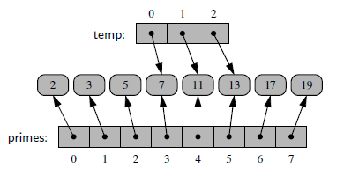
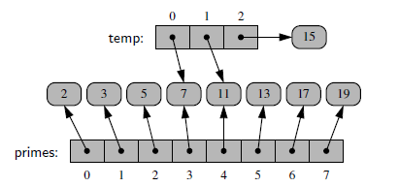
List instances can be referenced by more than one other lists
Fig 1: The result of the command temp = primes[3:6].
Fig 2: The result of the command temp[2] = 15
Notes:
A single list instance may include multiple references to the same object as elements of the list, and it is possible for a single object to be an element of two or more lists, as those lists simply store references back to that object. As an example, when you compute a slice of a list, the result is a new list instance, but that new list has references to the same elements that are in the original list.
When the elements of the list are immutable objects, as with the integer instances in Figure 1, the fact that the two lists share elements is not that significant, as neither of the lists can cause a change to the shared object. If, for example, the command temp[2] = 15 were executed from this configuration, that does not change the existing integer object; it changes the reference in cell 2 of the temp list
to reference a different object. The resulting configuration is shown in Figure 2.

Slide 12
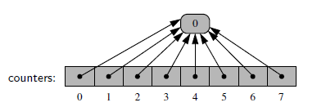
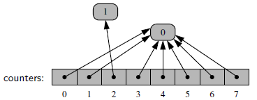
Initialisation of list with default immutable objects
Fig 1: The result of the command counters= [0] * 8
Fig 2: The result of command counters[2] += 1
Notes:
it is a common practice in Python to initialize an array of integers using a syntax such as counters = [0] * 8. This syntax produces a list of length eight, with all eight elements being the value zero. Technically, all
eight cells of the list reference the same object, as portrayed in Figure 1
At first glance, the extreme level of aliasing in this configuration may seem alarming. However, we rely on the fact that the referenced integer is immutable. Even a command such as counters[2] += 1 does not technically change the value of the existing integer instance. This computes a new integer, with value 0+1, and sets cell 2 to reference the newly computed value. The resulting configuration is shown in Figure 2

Slide 13
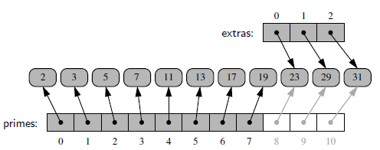
Extending a list
The effect of command primes.extend(extras), shown in light gray.
Notes:
The extend command is used to add all elements from one list to the end of another list. The
extended list does not receive copies of those elements, it receives references to
those elements

Slide 14
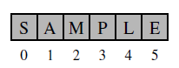
Benefits of compact arrays
Compact array - array is storing the bits that represent the primary data (characters, in the case of strings), and not the references
Lower overall memory usage
there is no overhead devoted to the explicit storage of the sequence of memory references (in addition to the primary data).
Better performance as data are stored consecutively in memory
Notes:
Lower overall memory usage: A referential structure will typically use 64-bits for the memory address stored in the array, on top of whatever number of bits are used to represent the object that is considered the element. Each Unicode character stored in a compact array within a string typically requires 2 bytes. If each character were stored independently as a one-character string, there would be significantly more bytes used
As another case study, suppose we wish to store a sequence of one million, 64-bit integers. In theory, we might hope to use only 64 million bytes. However, we estimate that a Python list will use four to five times as much memory. Each element of the list will result in a 64-bit memory address being stored in the primary array, and an int instance being stored elsewhere in memory. Python allows you to query the actual number of bytes being used for the primary storage of any object. This is done using the getsizeof function of the sys module. On our system, the size of a typical int object requires 14 bytes of memory (well beyond the 4 bytes needed for representing the actual 64-bit number). In all, the list will be using 18 bytes per entry, rather than the 4 bytes that a compact list of integers would require.
Better performance as data are stored consecutively in memory: Another important advantage to a compact structure for high-performance computing is that the primary data are stored consecutively in memory. Note well that this is not the case for a referential structure. That is, even though a list maintains
careful ordering of the sequence of memory addresses, where those elements reside in memory is not determined by the list. Because of the workings of the cache and memory hierarchies of computers, it is often advantageous to have data stored in memory near other data that might be used in the same computations.

Slide 15
The Array Structure
An array is the most basic type of container.
Implemented at the hardware level.
Most languages provide arrays as a primitive type.
Can be used with a wide range of problems.

Slide 16
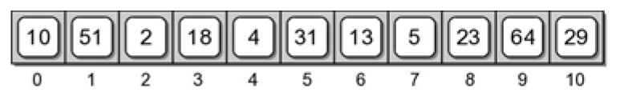
1-D Array
A sequence structure:
Composed of multiple elements, all the same type.
Elements are stored in contiguous bytes of memory.
Entire contents is known by a single name.
Individual elements can be accessed by subscript.

Slide 17
Array Implementation
Python is built using the C language.
High-level compiled language.
Provides syntax for working with the hardware.
Python provides the ctypes module
Access to C data types and functionality.
Provides for hardware-supported arrays.
Requires knowledge of C language.
Not meant for direct use in programs.

Slide 18
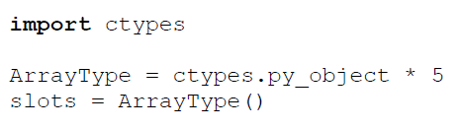
Hardware Array: Creation
Create a hardware array
fixed size
each element stores a reference to an object.

Slide 19
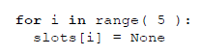
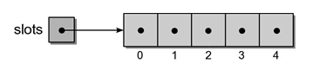
Hardware Array: Initialize
A hardware array has to be initialized before it can be used.
elements are like any other variable.
we must keep track of the size of the array.

Slide 20
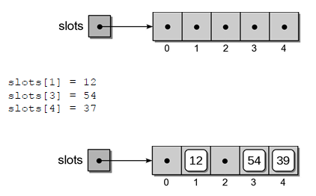
Hardware Array: Add
References can be stored in any array element.

Slide 21
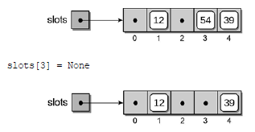
Hardware Array: Remove
Items can be removed from the array.

Slide 22
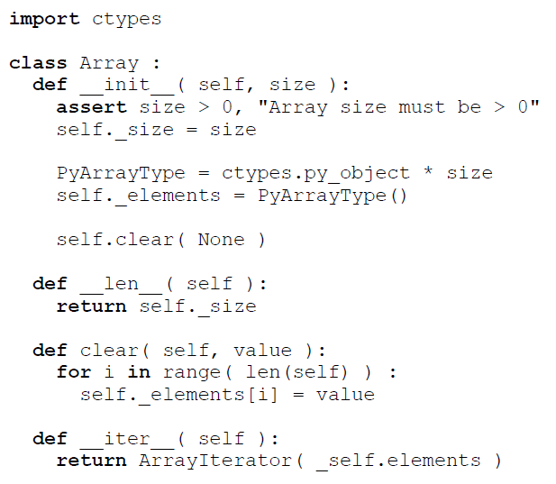
Array ADT Implementation

Slide 23
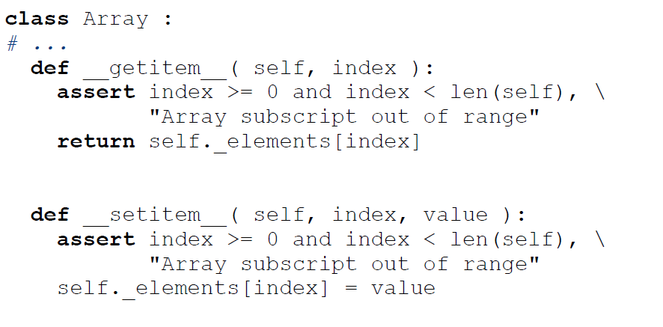
Array ADT Implementation

Slide 24
Python List
https://wiki.python.org/moin/TimeComplexity
Internally, a list is represented as an array, but with ability to resize
Fast
access (get item, set item)
get length
Pop last item
Slow
Insert
Delete
Insert

Slide 25
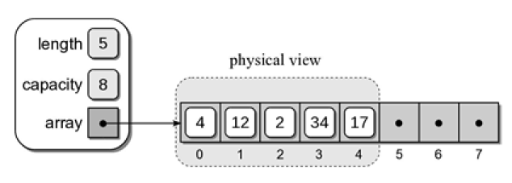
Python List: Implementation
An array is used to store the items of the list.
Created bigger than needed.
Has capacity for future items.
subarray – the items are stored in a contiguous subset of the array.
Notes:
Python, as indicated earlier, is built using the C language with many of the data
types and classes available in Python actually implemented using appropriate types
available in C. Python's list structure is a mutable sequence container that can
change size as items are added or removed. It is an abstract data type that is
implemented using an array structure to store the items contained in the list.

Slide 26
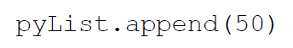
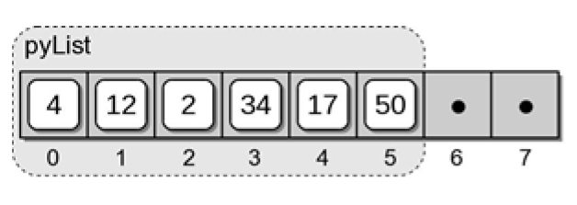
Python List: Appending an Item
New items can be added at the end of the list.
When space is available, the item is stored in the next slot.

Slide 27
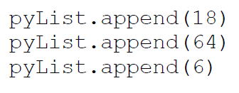
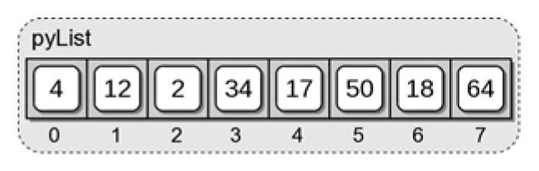
Python List: Appending an Item
What happens when the array becomes full?
There is no space for value 6.

Slide 28
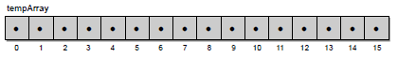
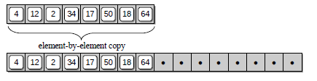
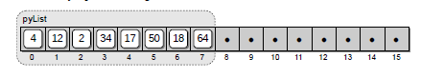
Python List: Expanding an Array
You must create a whole new larger array, doubled the size
Copy each item into the new array, one at a time…
Put the 6 (that wouldn’t fit) in its place…
Delete the old array. (Return the space to the OS.)
Notes:
By definition, a list can contain any number of items and never becomes full.
Thus, when the third statement is executed, the array will have to be expanded to make room for value 6. From the discussion in the previous section, we know an array cannot change size once it has been created.
To allow for the expansion of the list, the following steps have to be performed:
a new array is created with additional capacity,
the items from the original array are copied to the new array,
the new larger array is set as the data structure for the list, and
The original smaller array is destroyed. After the array has been expanded, the value can be appended to the end of the list.
In Python, the amount by which the size of the array is increased is proportional to the current array size. For illustration purposes, we assume an expansion creates a new array that is double the size of
the original. The result of expanding the array and appending value 6 to the list is shown in Figure.

Slide 29
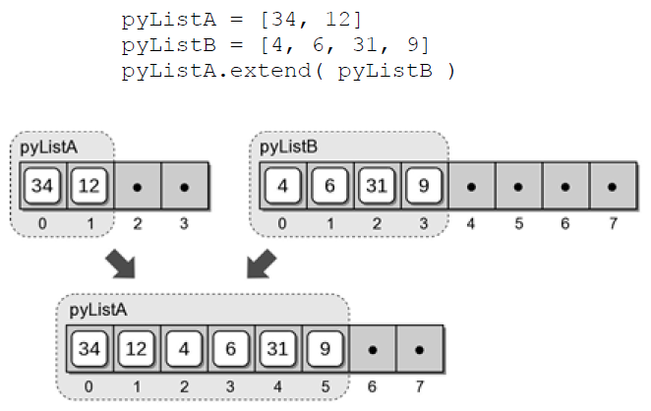
Python List: Extending a List
If the space permits, the entire contents of a list can be appended to a second list.
Else, will have to expand the array as in append() when array is full
Notes:
A list can be appended to a second list using the extend() method as shown in the following example:
pyListA = [ 34, 12 ]
pyListB = [ 4, 6, 31, 9 ]
pyListA.extend( pyListB )
If the list being extended has the capacity to store all of the elements from the second list, the elements are simply copied, element by element. If there is not enough capacity for all of the elements, the underlying array has to be expanded as was done with the append() method. Since Python knows how big the array needs to be in order to store all of the elements from both lists, it only requires a single expansion of the destination list, pyListA. The new array will be created larger than needed to allow more items to be added to the list without first requiring an immediate expansion of the array. After the new array is created, elements from the destination list are copied to the new array followed by the elements from the source list, pyListB, as illustrated in Figure.

Slide 30
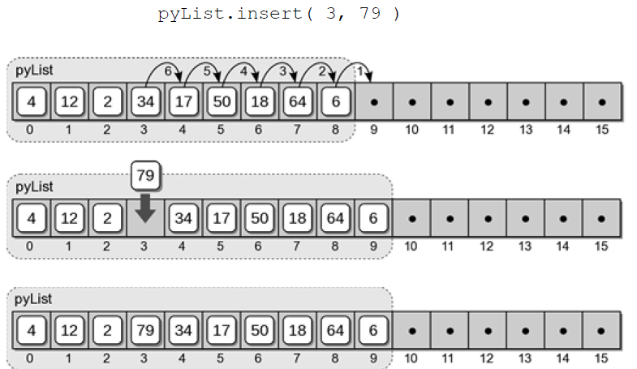
Python List: Inserting Items
An item can be inserted anywhere within the list.
Notes:
An item can be inserted anywhere within the list using the insert() method. In the following example
pyList.insert( 3, 79 )
we insert the value 79 at index position 3. Since there is already an item at that position, we must make room for the new item by shifting all of the items down one position starting with the item at index position 3. After shifting the items, the value 79 is then inserted at position 3 as illustrated in Figure. If there are no free slots for the new item, the list will be expanded in the same fashion as described earlier.

Slide 31
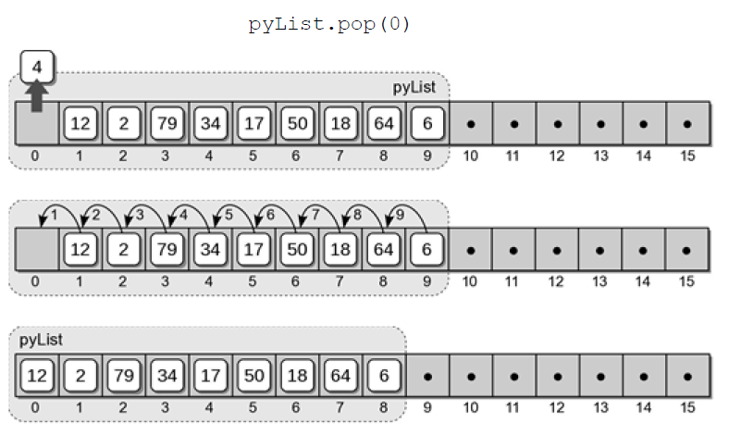
Python List: Removing Items
An item can be removed from position of the list.
Notes:
An item can be removed from any position within the list using the pop() method.
Consider the following code segment, which removes both the first and last items
from the sample list:
pyList.pop( 0 ) # remove the first item
pyList.pop() # remove the last item
The first statement removes the first item from the list. After the item is removed, typically by setting the reference variable to None, the items following it within the array are shifted down, from left to right, to close the gap. Finally, the length of the list is decremented to reflect the smaller size. Figure illustrates the process of removing the first item from the sample list. The second pop() operation in the example code removes the last item from the list. Since there are no items following the last one, the only operations required are to remove the item and decrement the size of the list.
After removing an item from the list, the size of the array may be reduced using a technique similar to that for expansion. This reduction occurs when the number of available slots in the internal array falls below a certain threshold. For example, when more than half of the array elements are empty, the size of the array may be cut in half.

Slide 32
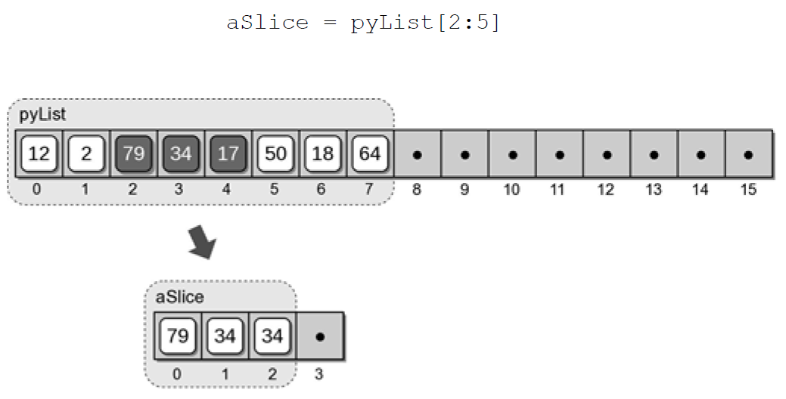
Python List: Slices
Slicing a list creates a new list from a contiguous subset of elements.
Notes:
To slice a list, a new list is created with a capacity large enough to store the entire subset of elements plus additional space for future insertions. The elements within the specified range are then copied, element by element, to the new list. The original list is not modied by this operation.

Slide 33
Homework
Half problem set
Implement your version of a ‘dynamic array’ allowing for the size of the array to grow to accommodate for array resizing
Comment on the performance, in terms of Big-O notation, of your implementation.

